Slide 1

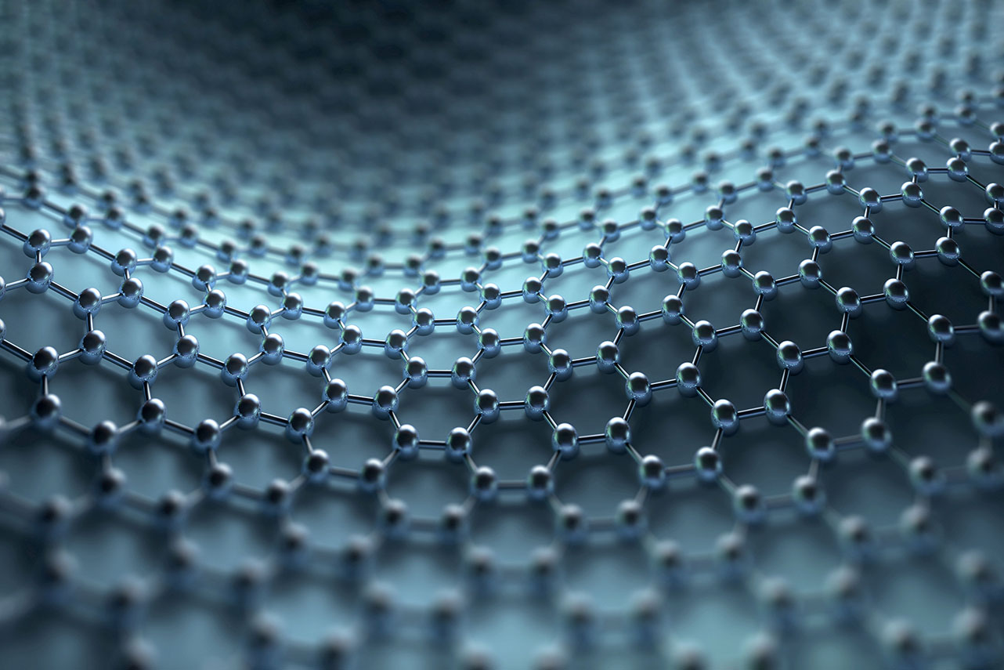
Auto-Encoder
Moriya bitton, yuval ben Yaakov

Slide 2
Introduction
In this part of the project, we created a model that could study the features of the image.
We will want to teach the model the properties of the image so that when the rest has damaged the image, whether it is a cut, dirt, or any other defect, we can assemble the missing part given the DNA of the image we have studied.
We will use Auto-Encoder to build, test, and train our model.

Slide 3
Task definition
We planted damage in our image of the type: "salt and pepper" noise.
We'll train our model on the original and the damaged photos.
Next, our model gets as input only damage photos and we would like to see how he fix the damages and return as a new photo, close as possible to the original image without the damages.

Slide 4
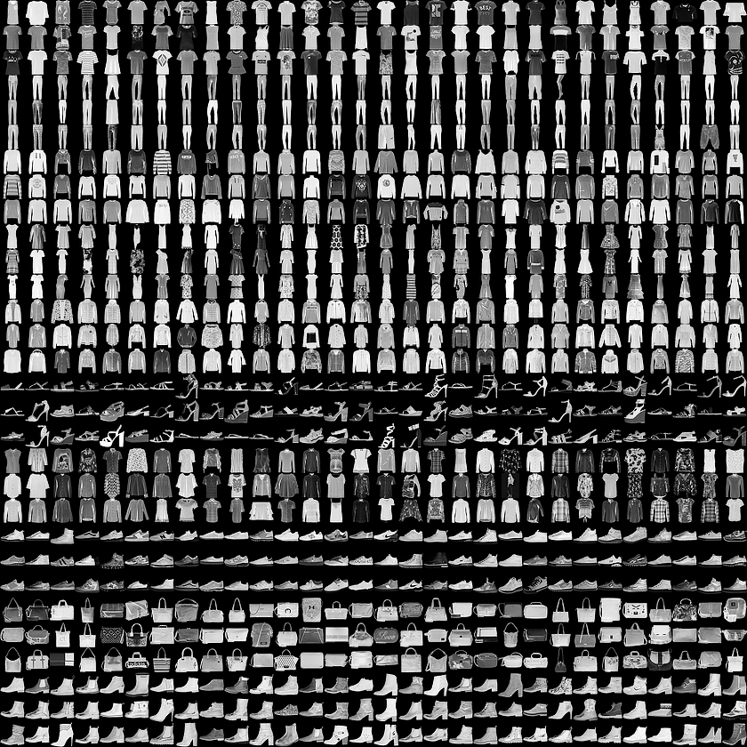
Dataset
We'll use the ‘fashin_mnist’ data set.
Fashion-MNIST is a dataset of a training set of 60,000 examples and a test set of 10,000 examples.
Each example is a 28x28 grayscale image, associated with a label from 10 classes.
We normalized the pixels to be in the range (0,1).
The noised data are randomly picked in size of 0.4.
https://github.com/zalandoresearch/fashion-mnist

Slide 5
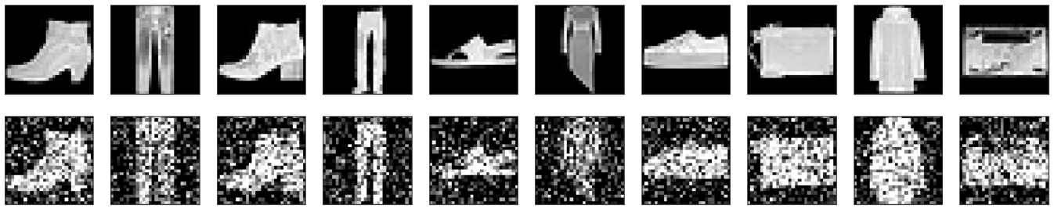
Before and after the damage

Slide 6
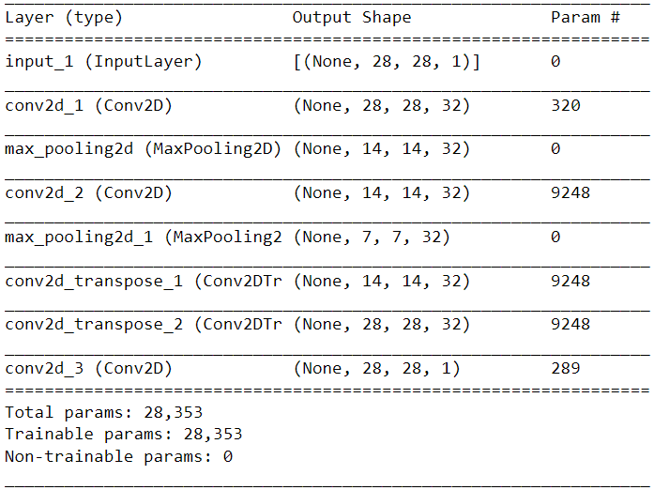
Attempts summary

Slide 7
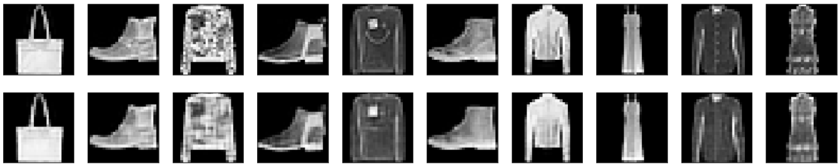
Original Images prediction

Slide 8
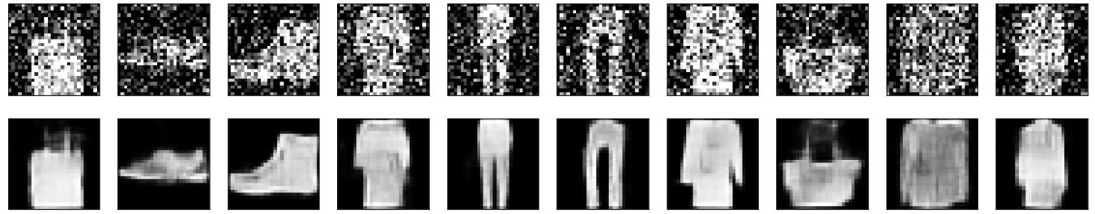
Damage Images prediction

Slide 9
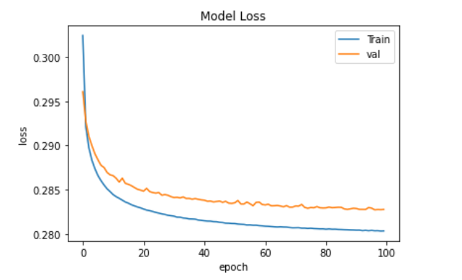
Estimation of loss

Slide 10
Conclusions
In this project, we are presenting a solution for fixing noise from images using deep learning.
Build a model that takes a damaged image and use the Auto-Encoder model to learn the Image DNA and "solve" the missing area of the image.
Our results were obtained by the "Adam" optimizer and "binary cross-entropy" loss function.

Slide 11
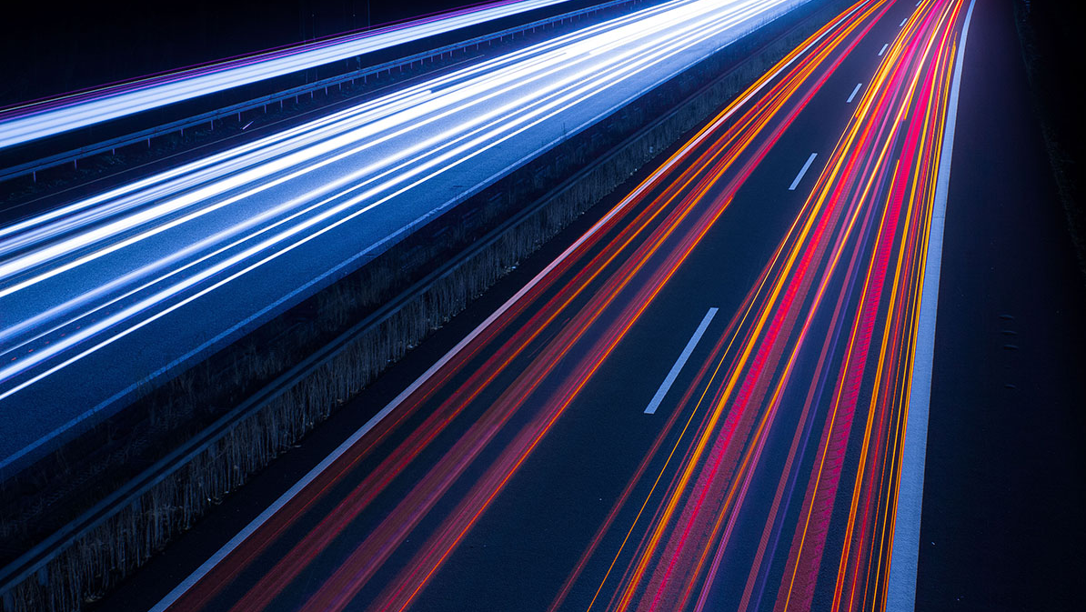
Thanks!
https://github.com/MoriyaBitton/Deep_learning_and_natural_language_processing

